Slide 1
Activity-2
DAA
Name:Oviya R
Roll no:732925ADR067

Slide 2
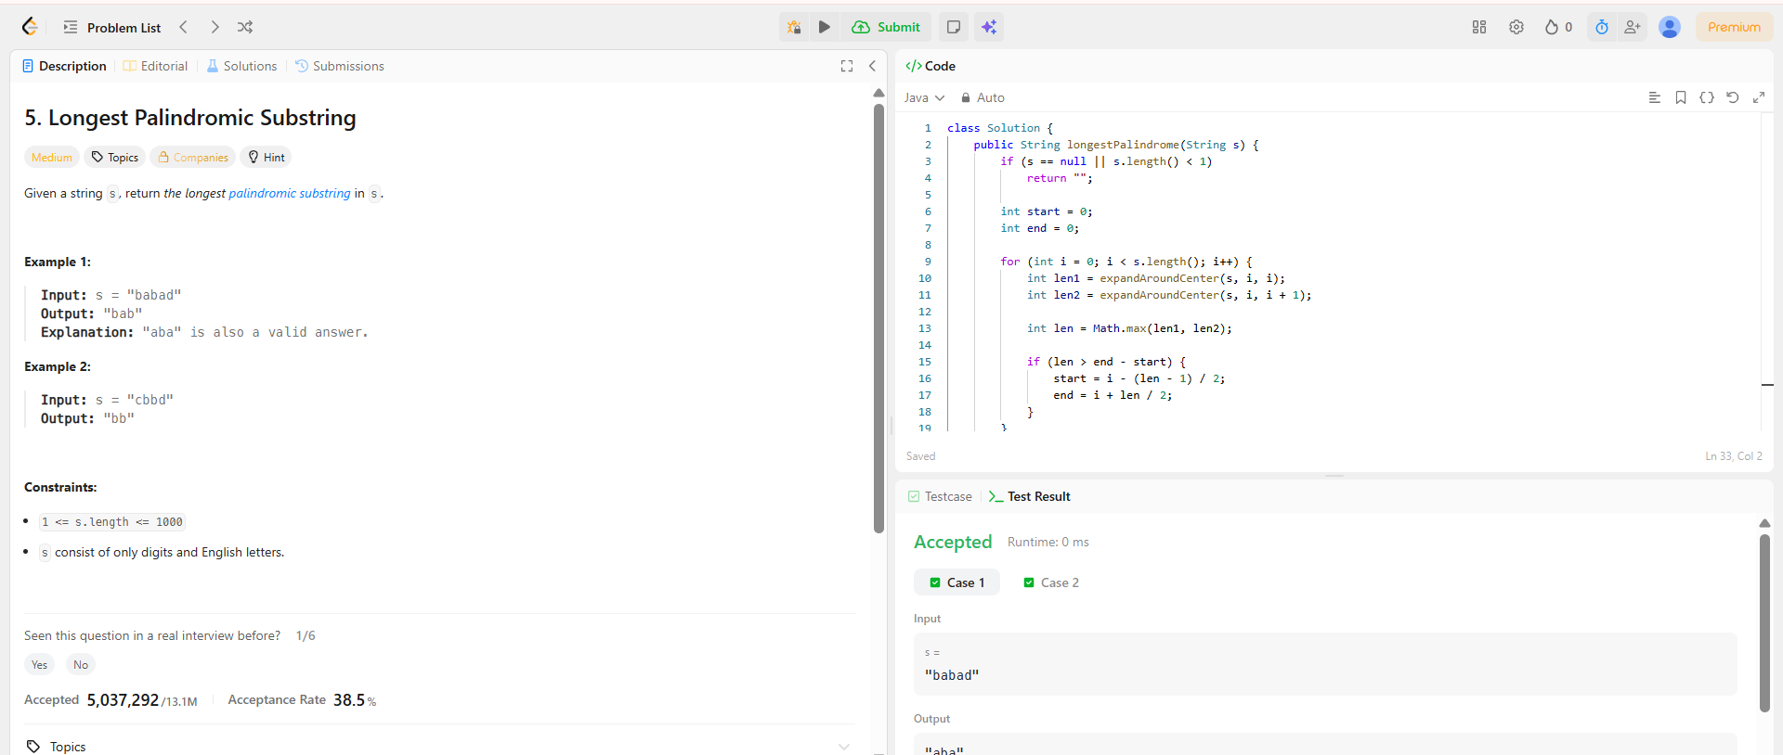

Slide 3
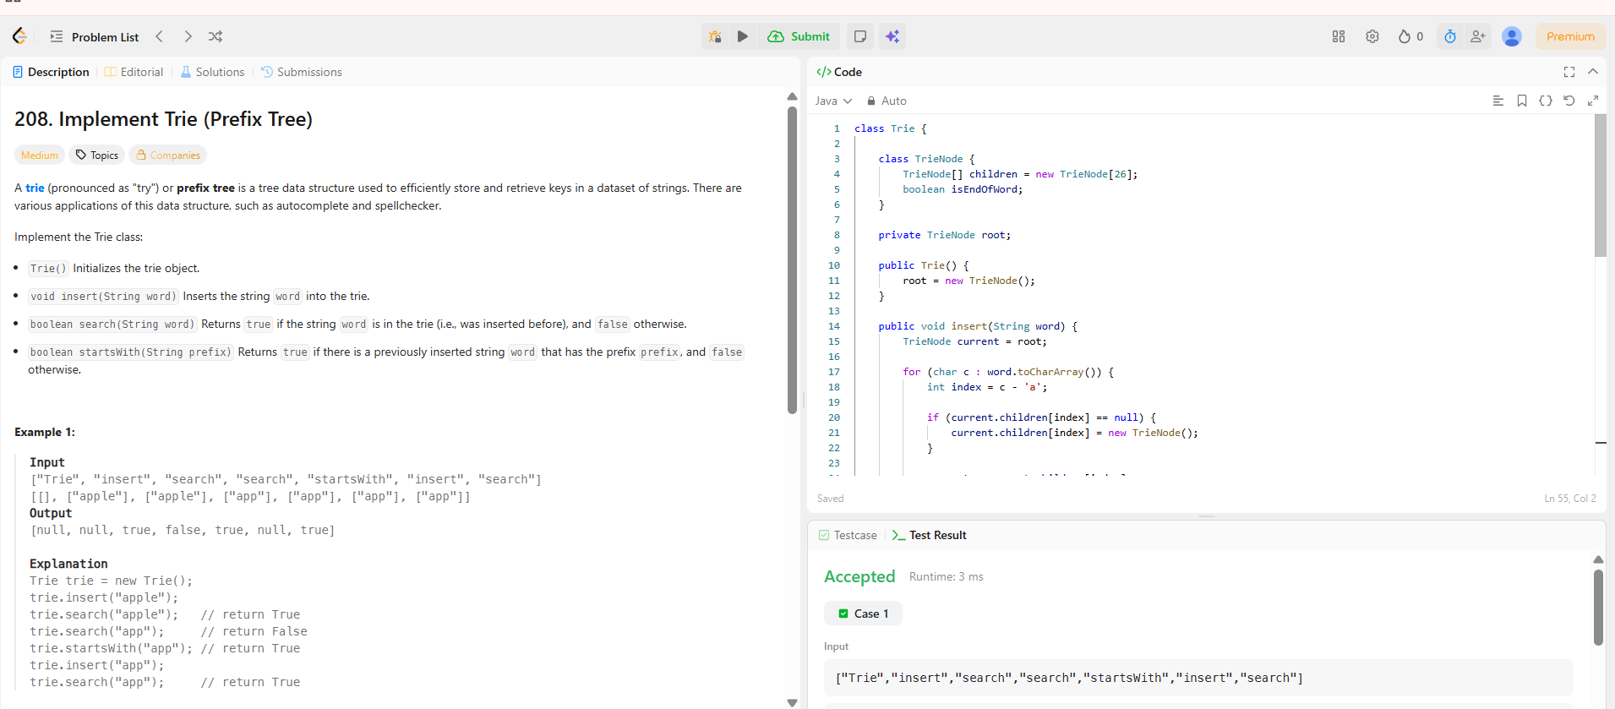

Slide 4
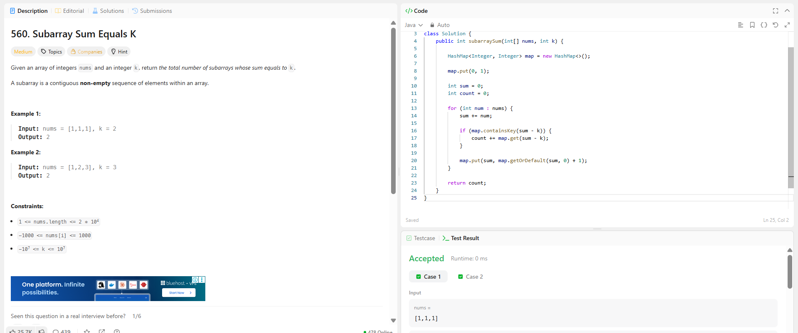

Slide 5
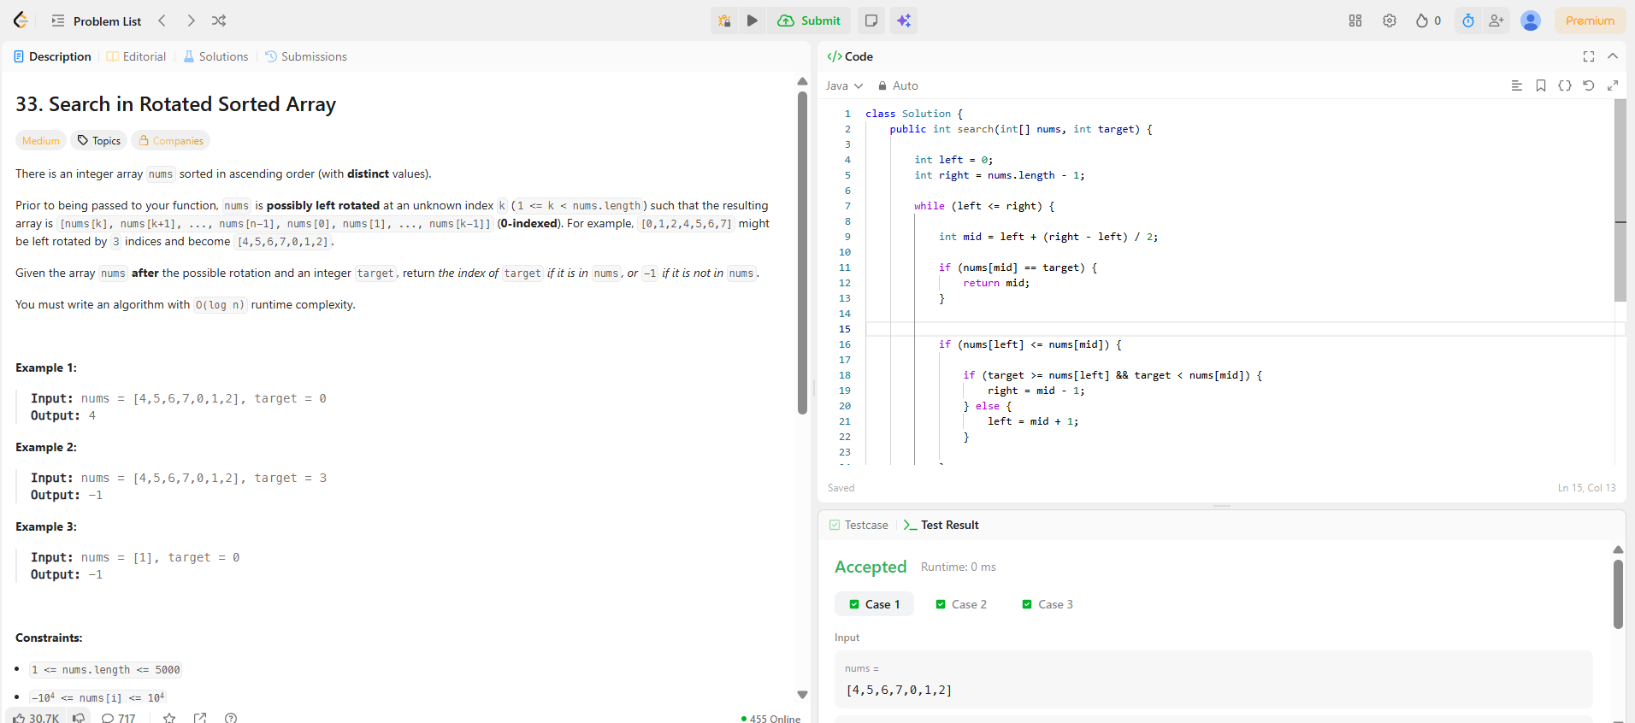

Slide 6
